Slide 1
HW#4 Review
Wen-Yen Hsu
Dept Electrical Engineering
Chang Gung University, Taiwan

Slide 2
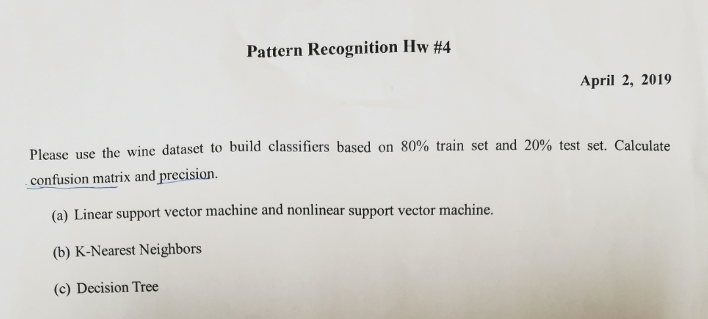
Question

Slide 3
Question

Slide 4
Preprocessing
df = pd.read_csv('wine.csv', header=0,
dtype={"Alcohol":"float64", "Malic acid":"float64",
"Ash":"float64", "Alcalinity of ash":"float64",
"Magnesium":"float64", "Total phenols":"float64",
"Flavanoids":"float64", "Nonflavanoid phenols":"float64",
"Proanthocyanins":"float64", "Color intensity":"float64",
"Hue":"float64", "OD280/OD315 of diluted wines":"float64",
"Proline ":"float64"})
y = df.iloc[:, 0].values
print(y.shape)
X = df.iloc[:, 1:].values
print(X.shape)
X_train, X_test, y_train, y_test = train_test_split(
X, y, test_size=0.2, random_state=1, stratify=y)
sc = StandardScaler()
sc.fit(X_train)
X_train_std = sc.transform(X_train)
X_test_std = sc.transform(X_test)

Slide 5
SVM
from sklearn.metrics import confusion_matrix
from sklearn.metrics import precision_score
## Linear SVM
svm_lin = SVC(kernel='linear', C=10.0, random_state=1)
svm_lin.fit(X_train_std, y_train)
y_hat_svm_lin = svm_lin.predict(X_test_std)
print('svm_lin cm', confusion_matrix(y_test, y_hat_svm_lin))
print('svm_lin precision', precision_score(y_test, y_hat_svm_lin, average='micro'))

Slide 6
KSVM
## Kernel SVM
svm_k = SVC(kernel='rbf', random_state=1, gamma=0.10, C=10.0)
svm_k.fit(X_train_std, y_train)
y_hat_svm_k = svm_k.predict(X_test_std)
print('svm_k cm', confusion_matrix(y_test, y_hat_svm_k))
print('svm_k precision', precision_score(y_test, y_hat_svm_k, average='micro'))

Slide 7
KNN
## KNN
knn = KNeighborsClassifier(n_neighbors=5,
p=2,
metric='minkowski')
knn.fit(X_train_std, y_train)
y_hat_knn = knn.predict(X_test_std)
print('knn cm', confusion_matrix(y_test, y_hat_knn))
print('knn precision', precision_score(y_test, y_hat_knn, average='micro'))

Slide 8
Tree
## Decision tree
tree = DecisionTreeClassifier(criterion='gini',
max_depth=4,
random_state=1)
tree.fit(X_train, y_train)
y_hat_tree = tree.predict(X_test)
print('tree cm', confusion_matrix(y_test, y_hat_tree))
print('tree precision', precision_score(y_test, y_hat_tree, average='micro'))

